Slide 1
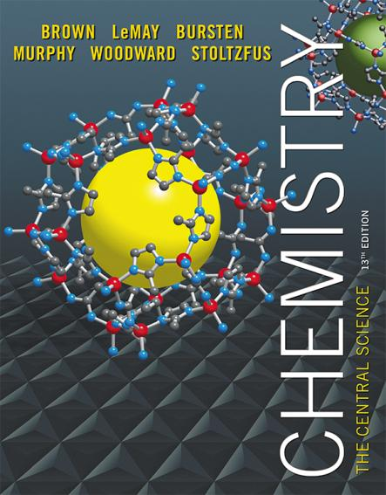
Lecture Presentation
Chapter 8 Basic Concepts of Chemical Bonding

Slide 2
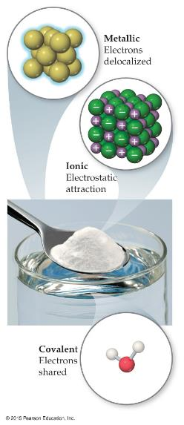
Chemical Bonds
Three basic types of bonds
Ionic
Electrostatic attraction between ions.
Covalent
Sharing of electrons.
Metallic
Metal atoms bonded to several other atoms.

Slide 3
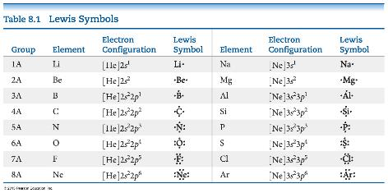
Lewis Symbols
G. N. Lewis developed a method to denote potential bonding electrons by using one dot for every valence electron around the element symbol.
When forming compounds, atoms tend to gain, lose, or share electrons until they are surrounded by eight valence electrons (the octet rule).

Slide 4

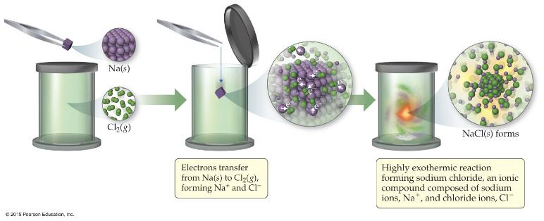
Ionic Formation
Atoms tend to lose (metals) or gain (nonmetals) electrons to make them isoelectronic to the noble gases.

Slide 5
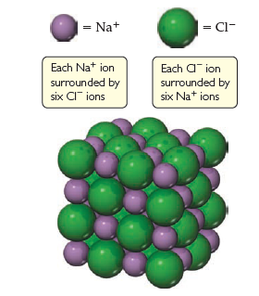
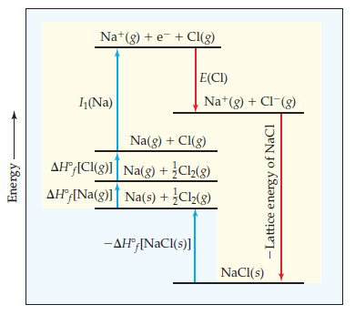
Energetics of Ionic Bonding— Born-Haber Cycle
Many factors affect the energy of ionic bonding.
Start with the metal and nonmetal elements: Na(s) and Cl₂(g).
Make gaseous atoms: Na(g) and Cl(g).
Make ions: Na⁺(g) and Cl–(g).
Combine the ions: NaCl(s).

Slide 6
Energetics of Ionic Bonding
We already discussed making ions (ionization energy and electron affinity).
It takes energy to convert the elements to atoms. (endothermic)
It takes energy to create a cation (endothermic).
Energy is released by making the anion (exothermic).
The formation of the solid releases a huge amount of energy (exothermic).
This makes the formation of salts from the elements exothermic.

Slide 7
Lattice Energy
That huge, exothermic transition is the reverse of the lattice energy,
the energy required to completely separate a mole of a solid ionic compound into its gaseous ions.
The energy associated with electrostatic interactions is governed by Coulomb’s law:
Q₁Q₂
d
E_{el} = κ
Notes:
Numerator, denominator

Slide 8
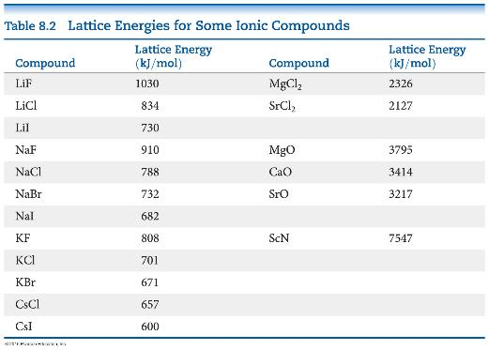
Lattice Energy
Lattice energy increases with:
increasing charge on the ions
decreasing size of ions

Slide 9
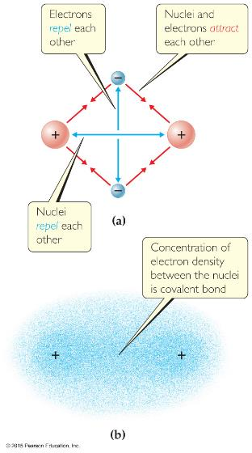
Covalent Bonding
In covalent bonds, atoms share electrons.
There are several electrostatic interactions in these bonds:
attractions between electrons and nuclei,
repulsions between electrons, and
repulsions between nuclei.
For a bond to form, the attractions must be greater than the repulsions.

Slide 10
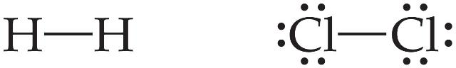
Lewis Structures
Sharing electrons to make covalent bonds can be demonstrated using Lewis structures.
We start by trying to give each atom the same number of electrons as the nearest noble gas by sharing electrons.
The simplest examples are for hydrogen, H₂, and chlorine, Cl₂, shown below.

Slide 11
Electrons on Lewis Structures
Lone pairs: electrons located on only one atom in a Lewis structure
Bonding pairs: shared electrons in a Lewis structure; they can be represented by two dots or one line

Slide 12

Multiple Bonds
Some atoms share only one pair of electrons. These bonds are called single bonds.
Sometimes, two pairs need to be shared. These are called double bonds.
There are even cases where three bonds are shared between two atoms. These are called triple bonds.

Slide 13
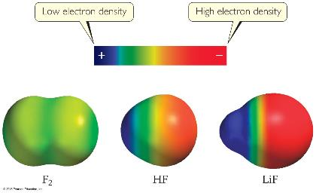
Polar Covalent Bonds
The electrons in a covalent bond are not always shared equally.
Fluorine pulls harder on the electrons it shares with hydrogen than hydrogen does.
Therefore, the fluorine end of the molecule has more electron density than the hydrogen end.

Slide 14
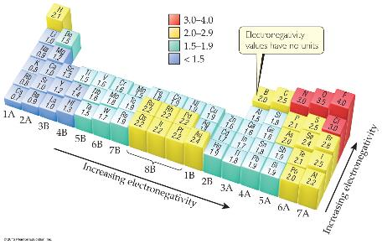
Electronegativity
Electronegativity is the ability of an atom in a molecule to attract electrons to itself.
On the periodic table, electronegativity generally increases as you go
from left to right across a period.
from the bottom to the top of a group.

Slide 15

Electronegativity and Polar Covalent Bonds
When two atoms share electrons unequally, a polar covalent bond results.
Electrons tend to spend more time around the more electronegative atom. The result is a partial negative charge (not a complete transfer of charge). It is represented by δ–.
The other atom is “more positive,” or δ+.

Slide 16
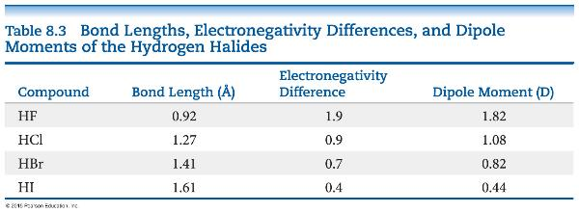
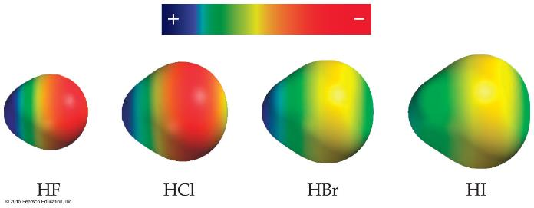
Polar Covalent Bonds
The greater the difference in electronegativity, the more polar is the bond.

Slide 17
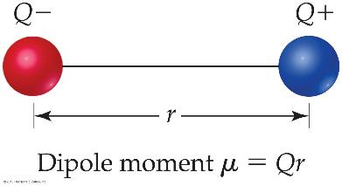
Dipoles
When two equal, but opposite, charges are separated by a distance, a dipole forms.
A dipole moment, μ, produced by two equal but opposite charges separated by a distance, r, is calculated:
μ = Qr
It is measured in debyes (D).

Slide 18
Is a Compound Ionic or Covalent?
Simplest approach: Metal + nonmetal is ionic; nonmetal + nonmetal is covalent.
There are many exceptions: It doesn’t take into account oxidation number of a metal (higher oxidation numbers can give covalent bonding).
Electronegativity difference can be used; the table still doesn’t take into account oxidation number.
Properties of compounds are often best: Lower melting points mean covalent bonding, for example.

Slide 19
Which kind of work a chemistry student will do in future?

Slide 20



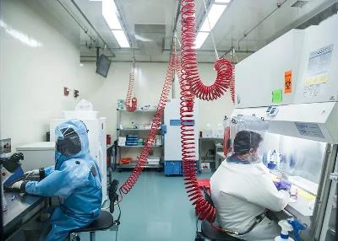
Working places of chemistry guys

Slide 21
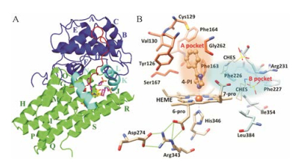
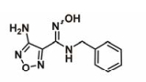
Crystal Structure of IDO1-4PI complex
Inhibitor
(抑制剂)
IDO1 is an enzyme （酶） that can inhibit immune system (免疫系统) to kill tumor （肿瘤）

Slide 22

$457,000,000.00

Slide 23
Writing Lewis Structures (Covalent Molecules)
Sum the valence electrons from all atoms, taking into account overall charge.
If it is an anion, add one electron for each negative charge.
If it is a cation, subtract one electron for each positive charge.
PCl₃
Keep track of the electrons:
5 + 3(7) = 26

Slide 24
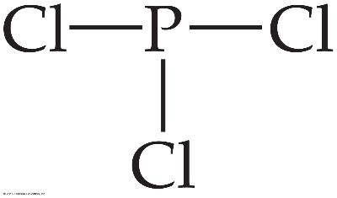
Writing Lewis Structures
Write the symbols for the atoms, show which atoms are attached to which, and connect them with a single bond (a line representing two electrons).
Keep track of the electrons:
26 − 6 = 20

Slide 25
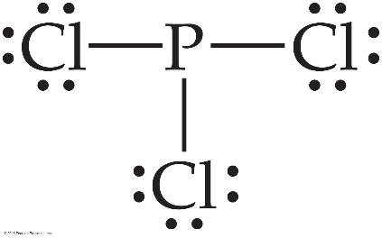
Writing Lewis Structures
Complete the octets around all atoms bonded to the central atom.
Keep track of the electrons:
26 − 6 = 20; 20 − 18 = 2

Slide 26
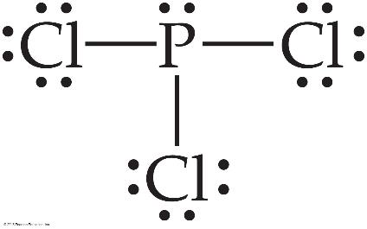
Writing Lewis Structures
Place any leftover electrons on the central atom.
Keep track of the electrons:
26 − 6 = 20; 20 − 18 = 2; 2 − 2 = 0

Slide 27
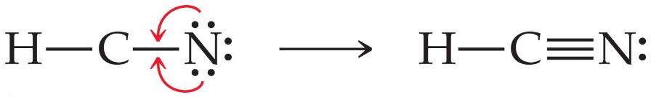
Writing Lewis Structures
5. If there are not enough electrons to give the
central atom an octet, try multiple bonds.

Slide 28
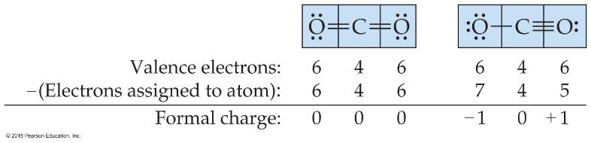
Writing Lewis Structures
Then assign formal charges.
Formal charge is the charge an atom would have if all of the electrons in a covalent bond were shared equally.
Formal charge = valence electrons – ½ (bonding electrons) – all nonbonding electrons

Slide 29
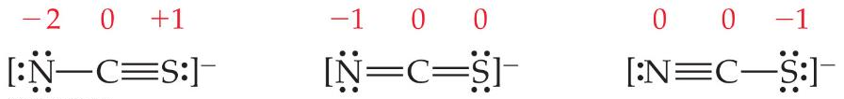
Writing Lewis Structures
The dominant Lewis structure
is the one in which atoms have formal charges closest to zero.
puts a negative formal charge on the most electronegative atom.

Slide 30
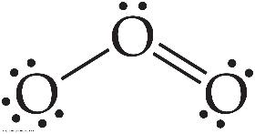
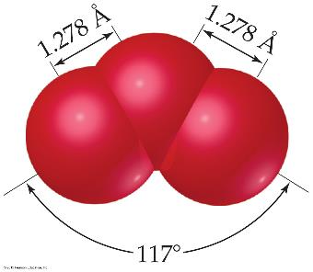
The Best Lewis Structure?
Following our rules, this is the Lewis structure we would draw for ozone, O₃.
However, it doesn’t agree with what is observed in nature: Both O to O connections are the same.
Notes:
Start here 6/11/10

Slide 31
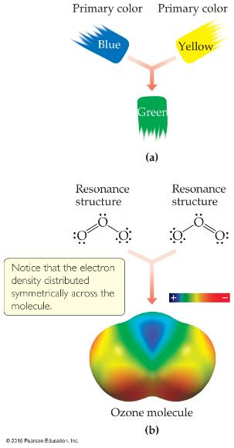
Resonance
One Lewis structure cannot accurately depict a molecule like ozone.
We use multiple structures, resonance structures, to describe the molecule.

Slide 32
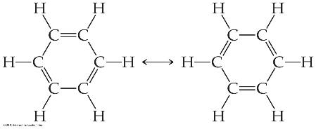

Resonance
The organic compound benzene, C₆H₆, has two resonance structures.
It is commonly depicted as a hexagon with a circle inside to signify the delocalized electrons in the ring.
Localized electrons are specifically on one atom or shared between two atoms; Delocalized electrons are shared by multiple atoms.

Slide 33
Exceptions to the Octet Rule
There are three types of ions or molecules that do not follow the octet rule:
ions or molecules with an odd number of electrons,
ions or molecules with less than an octet of valence electrons,
ions or molecules with more than eight valence electrons (an expanded octet).

Slide 34
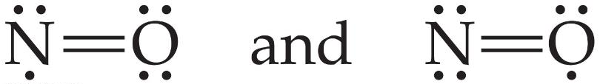
Odd Number of Electrons
Though relatively rare and usually quite unstable and reactive, there are ions and molecules with an odd number of electrons.
5+6 = 11 valence electrons

Slide 35
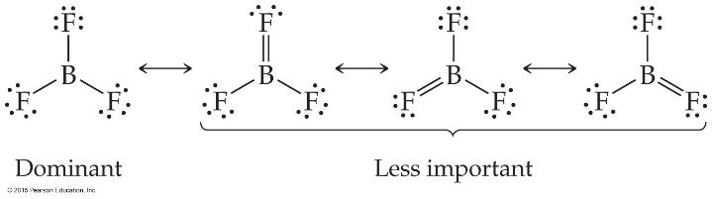
Fewer Than Eight Electrons
Elements in the second period before carbon can make stable compounds with fewer than eight electrons.
Consider BF₃:
Giving boron a filled octet places a negative charge on the boron and a positive charge on fluorine.
This would not be an accurate picture of the distribution of electrons in BF₃.

Slide 36
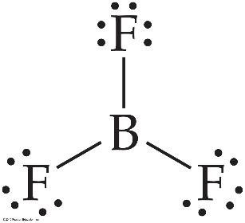
Fewer Than Eight Electrons
The lesson is: If filling the octet of the central atom results in a negative charge on the central atom and a positive charge on the more electronegative outer atom, don’t fill the octet of the central atom.

Slide 37
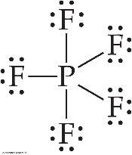
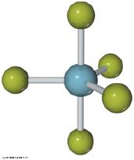
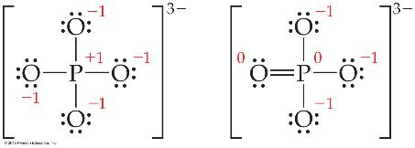
More Than Eight Electrons
When an element is in period 3 or below in the periodic table (e.g., periods 3, 4, 5, etc.), it can use d-orbitals to make more than four bonds.
Examples: PF₅ and phosphate below
(Note: Phosphate will actually have four resonance structures with five bonds on the P atom!)

Slide 38
Covalent Bond Strength
Most simply, the strength of a bond is measured by determining how much energy is required to break the bond.
This is called the bond enthalpy.
The bond enthalpy for a Cl—Cl bond, D(Cl— Cl), is measured to be 242 kJ/mol.
We write out reactions for breaking one mole of those bonds:
Cl—Cl → 2 Cl•

Slide 39
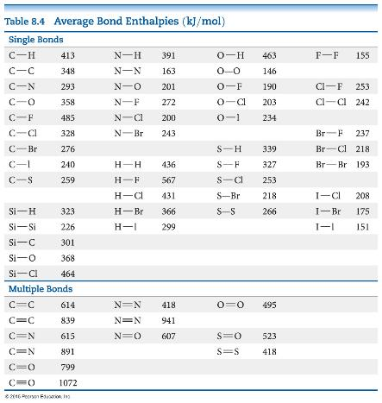
Average Bond Enthalpies
Average bond enthalpies are positive, because bond breaking is an endothermic process.
Note that these are averages over many different compounds; not every bond in nature for a pair of atoms has exactly the same bond energy.

Slide 40
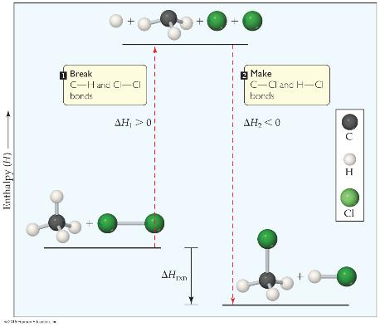
Using Bond Enthalpies to Estimate Enthalpy of Reaction
One way to estimate ΔH for a reaction is to use the bond enthalpies of bonds broken and the new bonds formed.
Energy is added to break bonds and released when making bonds.
In other words, ΔH_{rxn} = Σ(bond enthalpies of all bonds broken) − Σ(bond enthalpies of all bonds formed).

Slide 41
Example
From the figure on the last slide
CH₄(g) + Cl₂(g) ⎯⎯→ CH₃Cl(g) + HCl(g)
In this example, one C—H bond and one Cl—Cl bond are broken; one C—Cl and one H—Cl bond are formed.

Slide 42
Answer
ΔH = [D(C—H) + D(Cl—Cl)] − [D(C—Cl) +
D(H—Cl)]
= [(413 kJ) + (242 kJ)] − [(328 kJ) + (431 kJ)]
= (655 kJ) − (759 kJ)
= −104 kJ

Slide 43
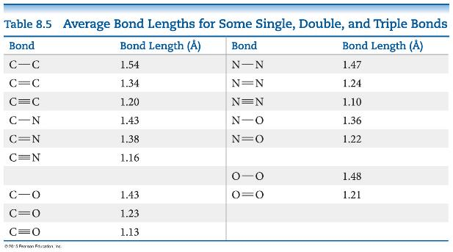
Bond Enthalpy and Bond Length
We can also measure an average bond length for different bond types.
As the number of bonds between two atoms increases, the bond length decreases.

